Slide 1
Research Paper
PRIORITIZED EXPERIENCE REPLAY
By: Tom Schaul, John Quan, Ioannis Antonoglou and David Silver

Slide 2
Experience Replay
A data structure that hold samples of experience for several steps
Replay Buffer
Mini batches
Q function
Exploration
Select action
Store experience
Environment

Slide 3
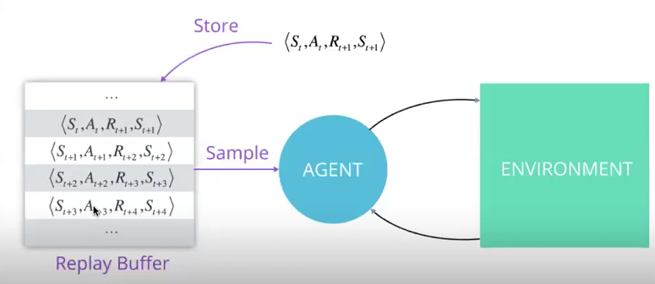
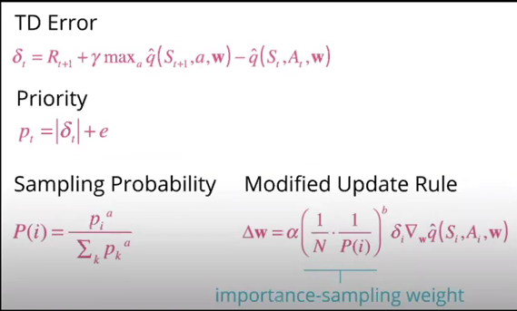
Prioritize Experience replay
Correlation between experiences
Sampling (i.i.d) independent identical distributed (random batches)
Buffer limited size
Some experience are rare and can be valuable
Priority assigned using TD error
Want to prioritize based on how much RL agent can learn from transition in current state
Indirect proxy is magnitude of TD error &, indicating how “surprising” the transition is

Slide 4
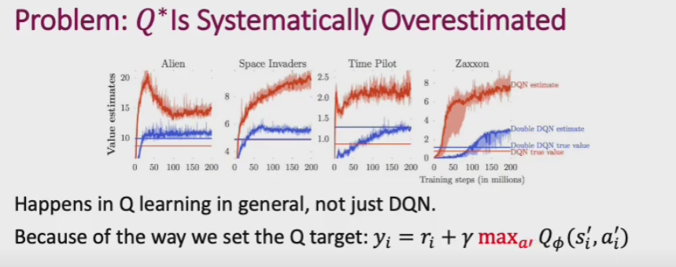
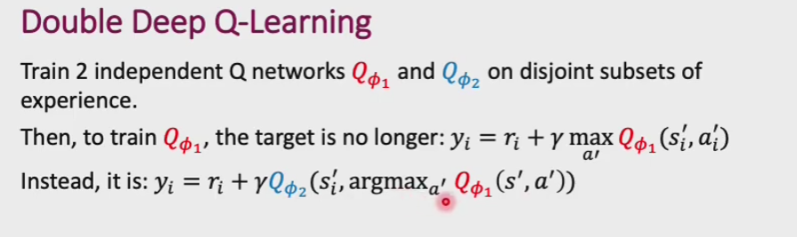
Q-Network and Double Q-Network
Q – network being trained is used to select actions
The other Q-network is used to evaluate actions

Slide 5
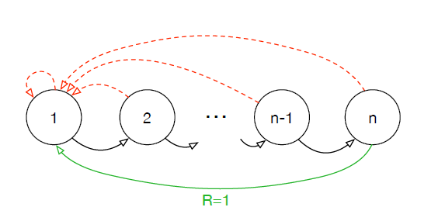
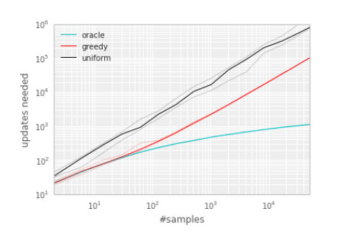
Example Prioritization
Example prioritization
Uniform agent randomly replays transitions uniformly
Implicit bias to outdated transitions / old policy
Some transitions are never replayed
Oracle greedily selects transition that maximally reduces global loss in current state
Greedy TD – error prioritization algorithm replays transition with largest absolute TD error
Notes:
Explain the scenario to get a reward. Graph shows the median number of updates required in order to learn the optimal policy
Comparison in the graph (three kind). Black one is uniform experience replay (Sample at random)
Oracle this is not really a viable strategy to implement when you're learning something because when you're learning something you don't know what's maximally going to reduce the global loss

Slide 6
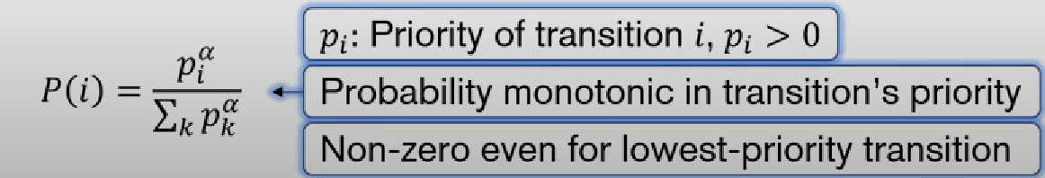
Example prioritization
In greedy TD – learning, errors are only updated for the replayed transitions.
Greedy TD – errors, shrink slowly, especially when using function approximation, meaning that initially high error transition get replayed frequently (over fitting)
Stochastic sampling method interpolates between pure greedy prioritization and uniform random sampling
Weight also applied using gradient descent
Notes:
Explain why TD error alone can cause problem, say if it approaches to 0 then is highly unlikely that we will revisit that particular state. And it can also cause over fitting
To avoid such we introduct a priority sampling where we can control the number of revisit in a state. you could add an alpha which is basically telling you how much you would um concentrate on on the states

Slide 7

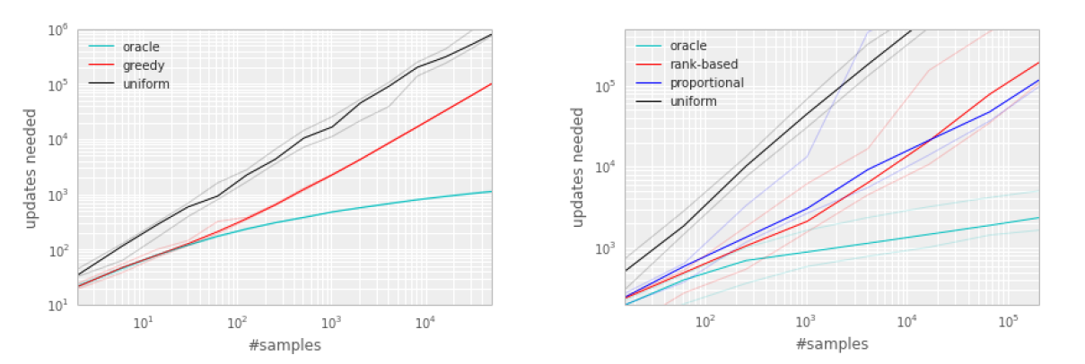

Example Stochastic Prioritization
Proportional prioritization where
E: Prevents transitions not being revested if error is zero
Rank-based prioritization where
Rank(i): Rank of transition i according to |&i|
These schemes that we are introducing here are actually providing significant uh benefit for the algorithm
Notes:
the epsilon here prevents transitions not being revisited if the error is zero so some sometimes you could be in such a state that the td error actually comes out to be zero
a rank based on magnitude of the tdr we instead set a priority that's inverse to to that particular rank now what this does is it makes uh the algorithm a lot more robust

Slide 8
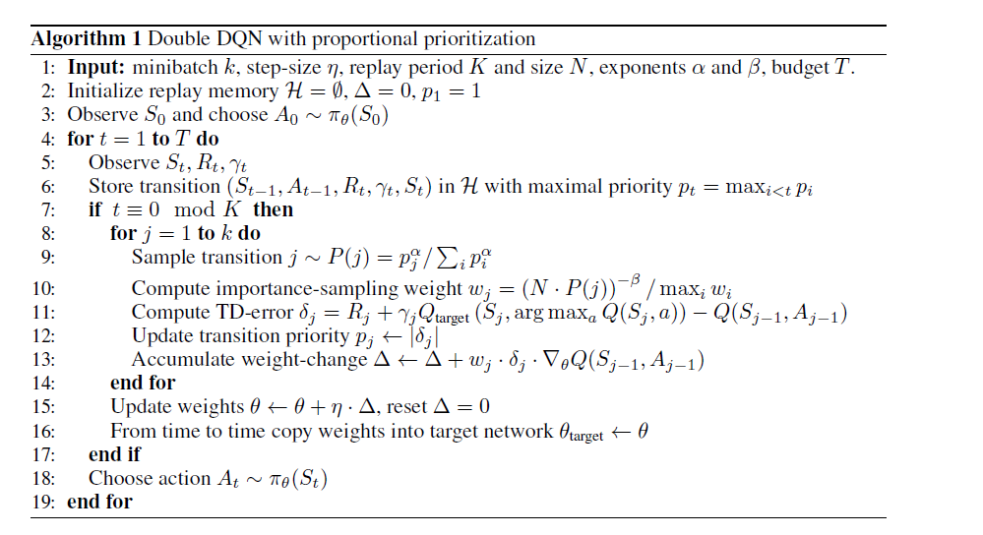
Double DQN Algorithm

Slide 9
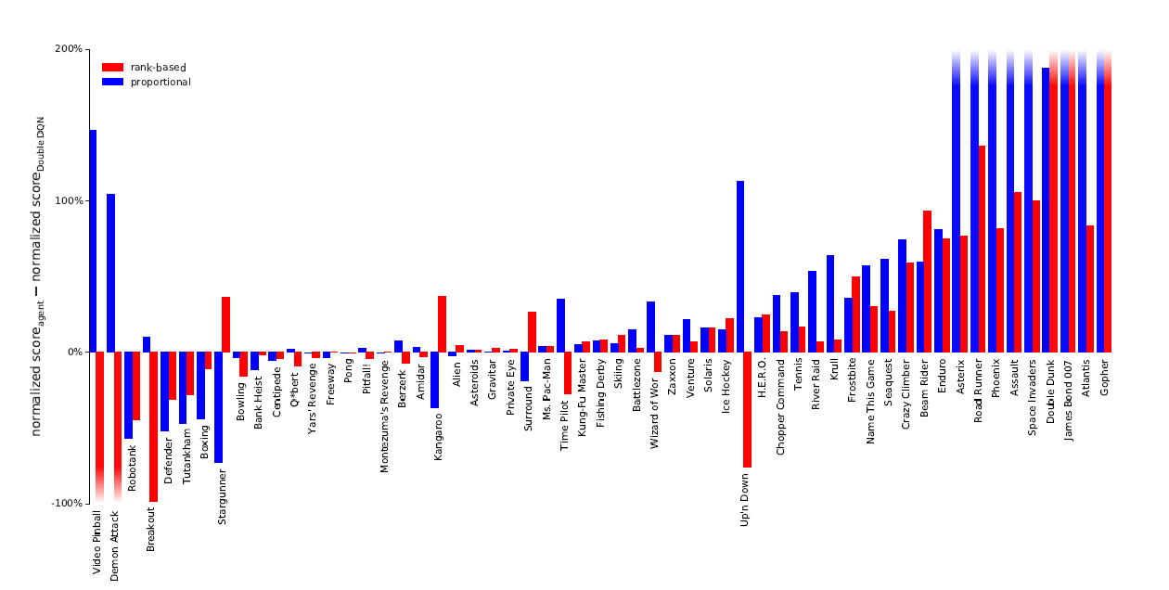

Comparison: Average episode score Prioritized vs uniform replay
Double DQN algorithm
Median performance across 57 games increased from 111% to 128%, and the mean performance from 418% to 551%
Prioritization variants perform similarly perhaps due to reward and TD – error clipping (TDRs)
if you wouldn't do this the prioritization would be so let's say uneven that it could easily lead to overfitting and instability in the algorithm
Notes:
Atari game to evaluate different algorithms
on the y-axis is the normalized score for the agent minus the normalized score
histogram is positive that means that our current agent performs better than the double dqm algorithm

Slide 10
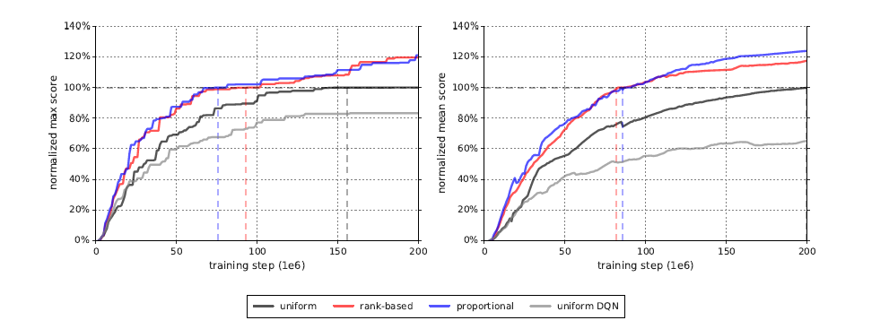
Learning speed Uniform vs priority replay
Median of maximum baseline normalized score (left) and mean baseline normalized score (right) over 57 games
how fast the optimal or maximum score increases as a function of training steps
learning speeds for this algorithm
Notes:
we take the maximum of that score for a given game and then we take the median across all games
and they reach the 100 level here basically at 47 and 43 of of training time
if we look at the right graph now uh this campaign compares the baseline normalized score over 57 games so and this is the the mean baseline normalized
they basically get to to this point at 43 of 41

Slide 11
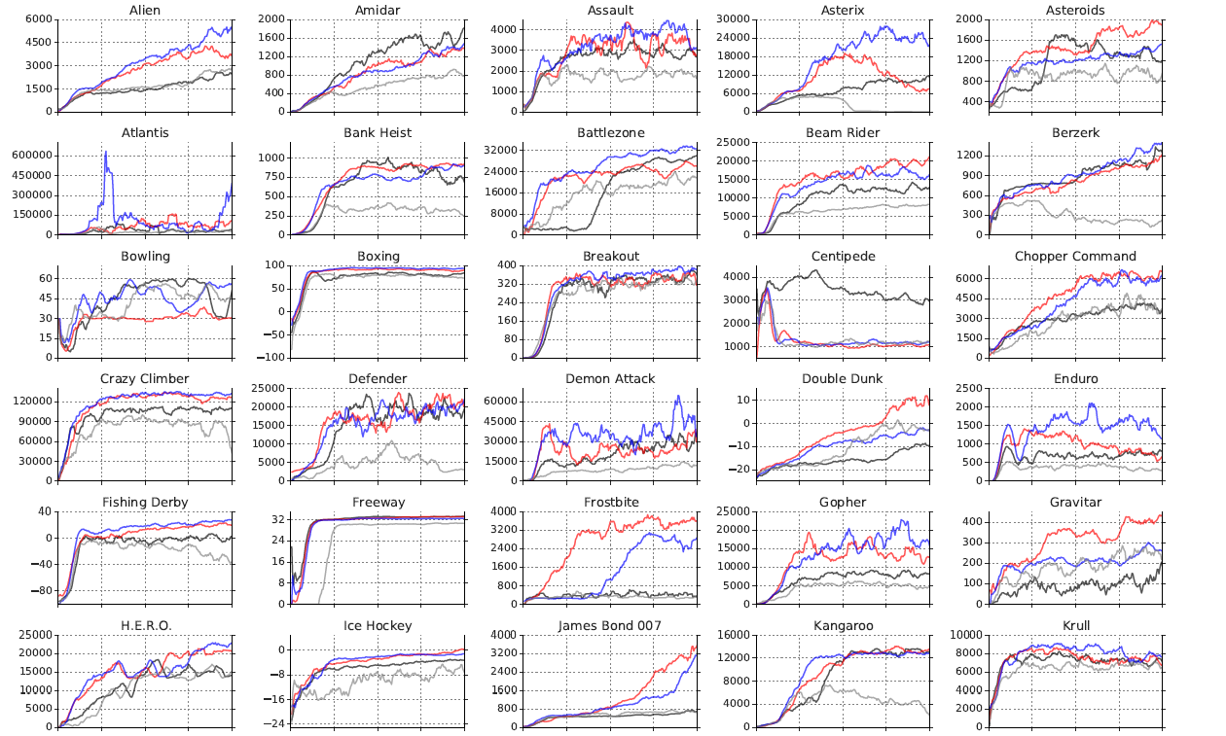
Learning curves
Prioritized replay to DQN leads to a substantial improvement in score on 41 out of 49 games
Median normalized performance across 49 games increasing from 48% to 106%
Prioritization reduces delay until performance gers off the ground for e.g. Battlezone, Zaxxon or Frostbite
Notes:
1. moreover we have three games that are marked out here so battle zone frostbite and on the next slide here uh zaxxon for these three games we can see that the uh new algorithms get off the ground quicker than the old ones so we can see here for the well uniform distribution or the uniform um sampling we it takes quite a while for us to start converging towards a policy that actually performs well whereas in the case of these prioritization schemes they seem to be doing a better job

Slide 12
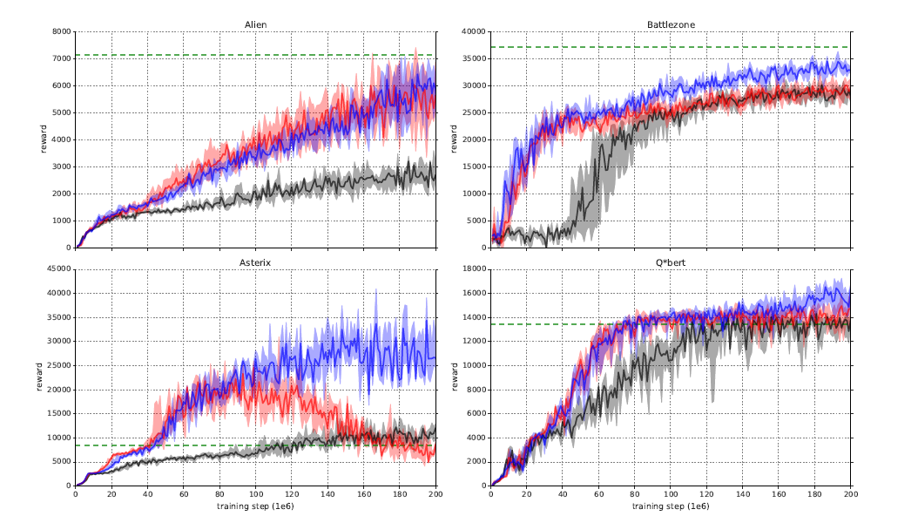
Learning Curve
Difference in final score
Difference in learning speed
Difference in Shaded area corresponds to the interquartile range
Notes:
reinforcement learning tasks require substantial infrastructure in order to train them efficiently more effectively um whenever whatever you can do to decrease the amount of iterations required to get to convergence is is obviously a good

Slide 13
Conclusion
No winners
The proportional prioritization outperforms the rant-based one but in other cases it seems to be inverted it might be that for tasks where the td error tends to have lots of outliers and be very well prone to high variance then it might be better to use the rank-based because it's a bit more robust and the proportional one might be better
Both of these method significantly increase performance so in general when constructing these kinds of algorithms using a priority-based replay memory buffer seems to be preferable as opposed to uniform sampling from that buffer

